Slide 1
Co-Designing Dashboards: Challenges & Opportunities During a Randomized Clinical Trial
W05
Elwin Wu, PhD
Columbia University
#IS24

Slide 2
Disclosure
I have no relevant relationships with commercial interests to disclose.

Slide 3
Learning objectives
After participating in this session, the learner should be better able to:
Recognize the need to balance expectations about co-design and an active trial
Consider concerns around study validity when designing a community dashboard

Slide 4

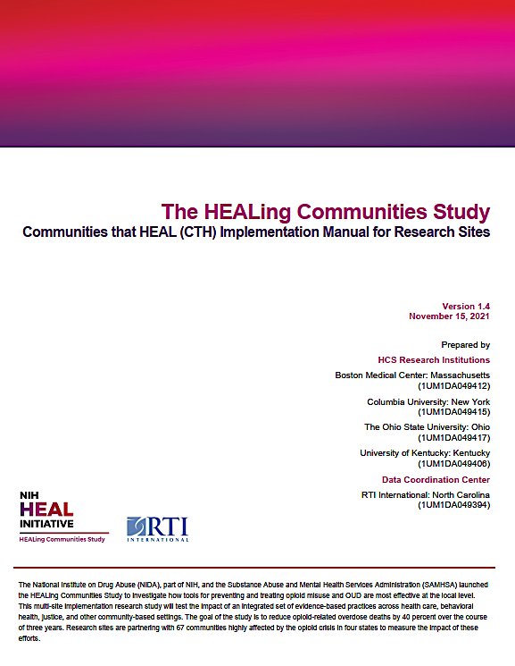
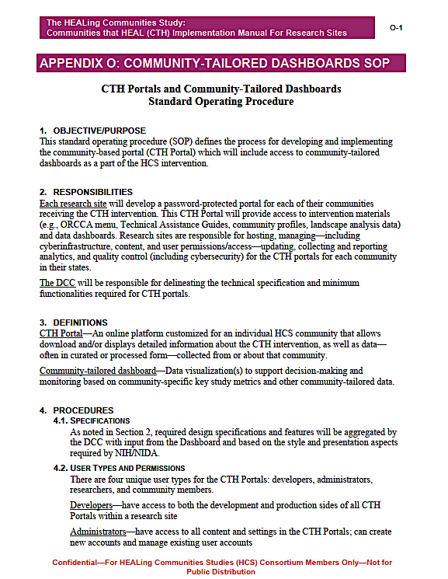
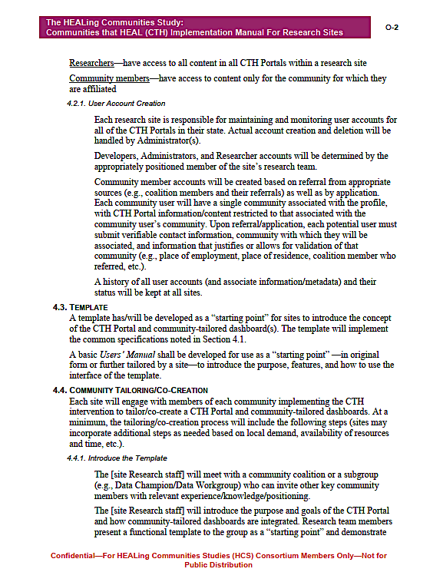
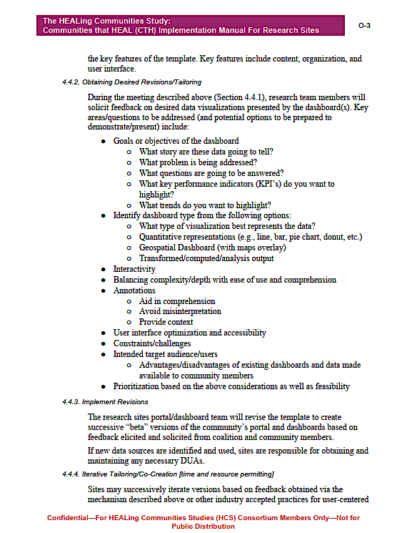

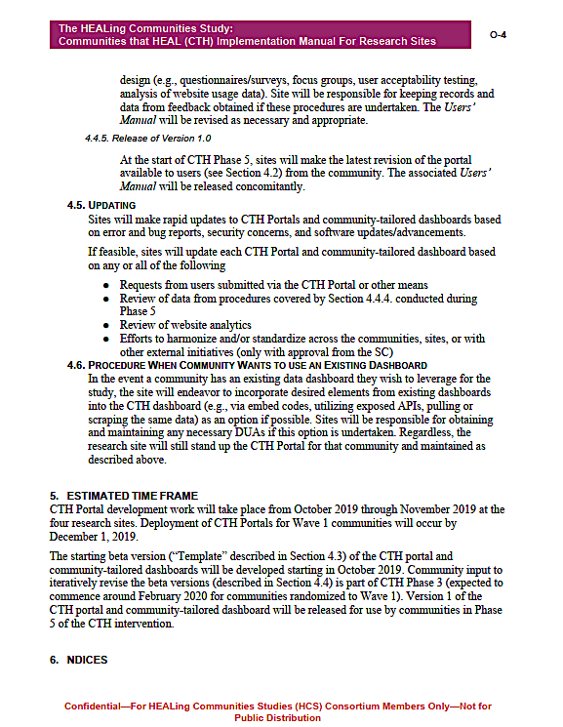
Community Co-Design of Dashboards: The Ideal

Slide 5
But this was a randomized clinical trial (RCT)
Internal Validity
External Validity
Ethics

Slide 6
Internal Validity
Internal Validity
Challenges
Preserve experimental assignment
May not match end user’s ecology
Prevent “contamination”
Access to some or all dashboards are restricted to vetted user accounts with password protection
Exporting visualizations/data prohibited
External Validity
Ethics

Slide 7
External Validity
Internal Validity
Challenges
Researchers have high data literacy that may not be matched by target user base/audience
Research tasks set/constrain:
Timeline
End user’s workflow
Standardization limits/constrains variability across sites, over time, data sources, etc.
External Validity
Ethics

Slide 8
Ethics
Internal Validity
Challenges
Protected information
Sensitive information
Confidentiality and anonymity
Data are not [necessarily] neutral:
Politics
Data/information for “nefarious” purposes (e.g., perpetuating/propagating stigma)
External Validity
Ethics

Slide 9
There are also opportunities!
Internal Validity
Systematic data collection for evaluation and evolution
Can build in “experiments” to optimize end user acceptance, understanding, and/or utility
Citizen science:
Democratization of research, data, etc.
Wisdom of the crowds/wisdom among the crowds (e.g., crowdsourcing)
External Validity
Ethics

Slide 10
Thank you!

